Slide 1

Image Acquisition Quality Influences the Accuracy and Performance of Computer Vision Systems
NAME: MOTHISH G
REG NO:192421135
COURSE: ITA-0506 COMPUTER VISION
FACULTY: JENI GRACIA

Slide 2


Introduction
What is Image Acquisition?
Image acquisition is the process of capturing digital images using cameras or sensors.
It is the first stage in every Computer Vision system.
The quality of captured images directly affects the performance of AI models.
Why is it Important?
Better image quality → Higher detection accuracy.
Poor image quality → Incorrect predictions and reduced system performance.
Common Image Sources
Digital Cameras
CCTV Cameras
Mobile Phone Cameras
Drones
Medical Imaging Devices

Slide 3
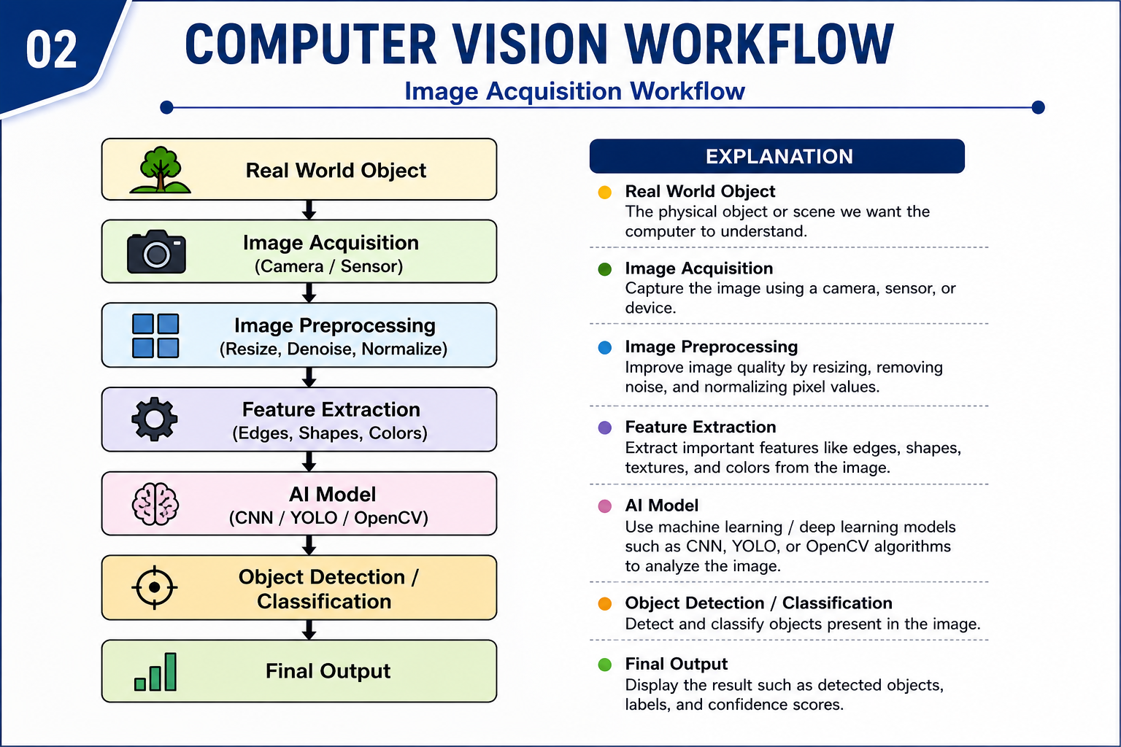
Computer Vision Workflow Diagram

Slide 4
Factors Affecting Image Quality
Factor | Good Quality | Poor Quality
Resolution | High | Low
Lighting | Bright & Balanced | Dark / Overexposed
Focus | Sharp | Blurred
Noise | Low | High
Camera Angle | Proper | Tilted
Motion | Stable | Motion Blur

Slide 5
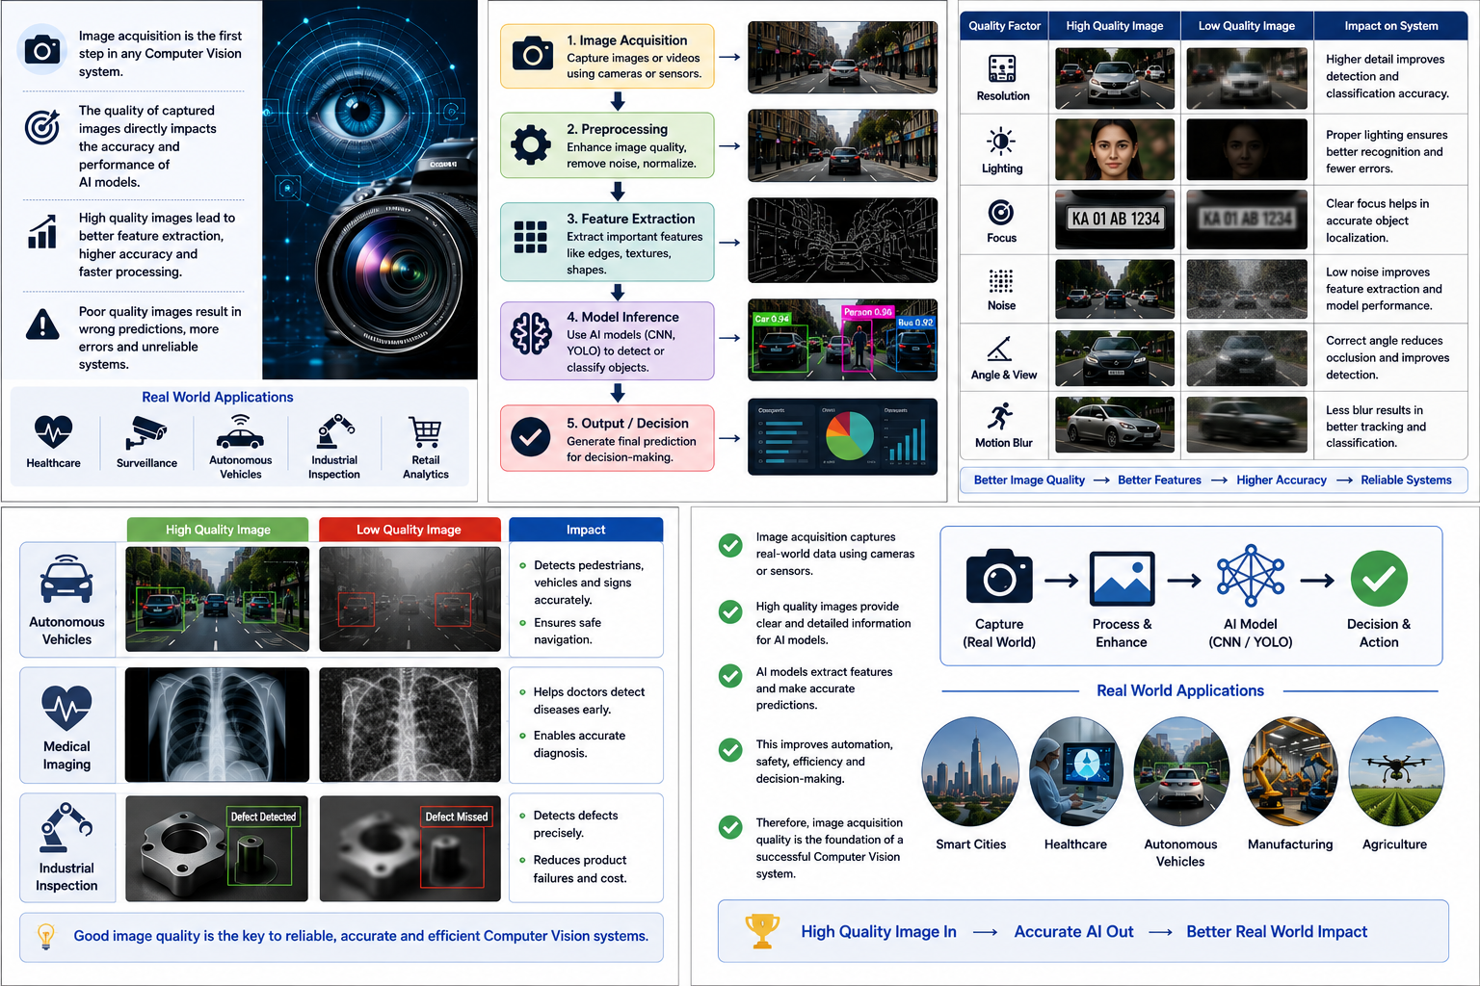

Slide 6
Conclusion
Image acquisition quality plays a vital role in the success of Computer Vision systems because it is the foundation for all subsequent image processing and analysis. High-quality images with proper resolution, lighting, focus, and minimal noise enable AI models to extract accurate features, resulting in better object detection, classification, and decision-making. Conversely, poor-quality images can reduce accuracy, increase false detections, and negatively impact system performance. Therefore, ensuring high-quality image acquisition is essential for building reliable, efficient, and accurate Computer Vision applications in areas such as healthcare, autonomous vehicles, industrial safety, surveillance, and robotics.

Slide 7
Thank you

